Slide 1
Investor Pitch Template
30 Point Font
1 to 3 “Points” Per slide
Use Graphics
Know Your Audience

Slide 2
Title Slide Company Name Company Logo
Contact Information

Slide 3
Problem/Solution
Insert Napkin Drawing
Succinct Statement of the Problem
Succinct Statement of the Solution
All from a “Market Perspective”
Problem – Solution - Napkin

Slide 4
Problem/Solution
Insert Napkin Drawing

Slide 5
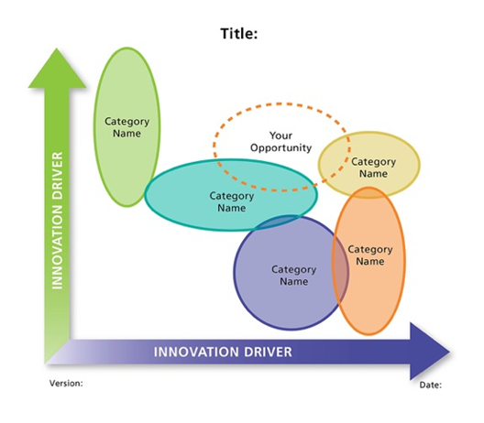
Product:Market Fit Market Opportunity Map

Slide 6
Product:Market Fit Market Segmentation

Slide 7
Size of Opportunity/Market
Include CAGR
TAM
SAM
SOM
LAM
or Current
With a summary of pertinent data
The basis of this analysis resides in your “Vault”
TAM – Total Addressable Market
SAM – Serviceable Addressable Market
SOM – Serviceable Obtainable Market
LAM – Launch Addressable Market

Slide 8
Regulatory Pathway
Sample
Clear
Succinct
Brief
Only if Applicable, for example…
FDA
USDA
CE

Slide 9
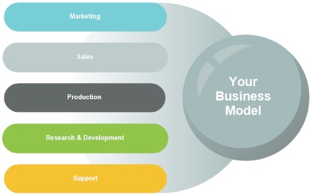
Business Model
Your Best Chance to Explain
Economies of the Innovation
And How That Impacts Things Like
COGS
Margin
GS & A

Slide 10
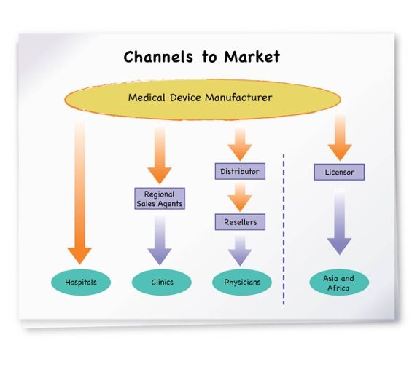
Go To Market Plan – Channel Management

Slide 11
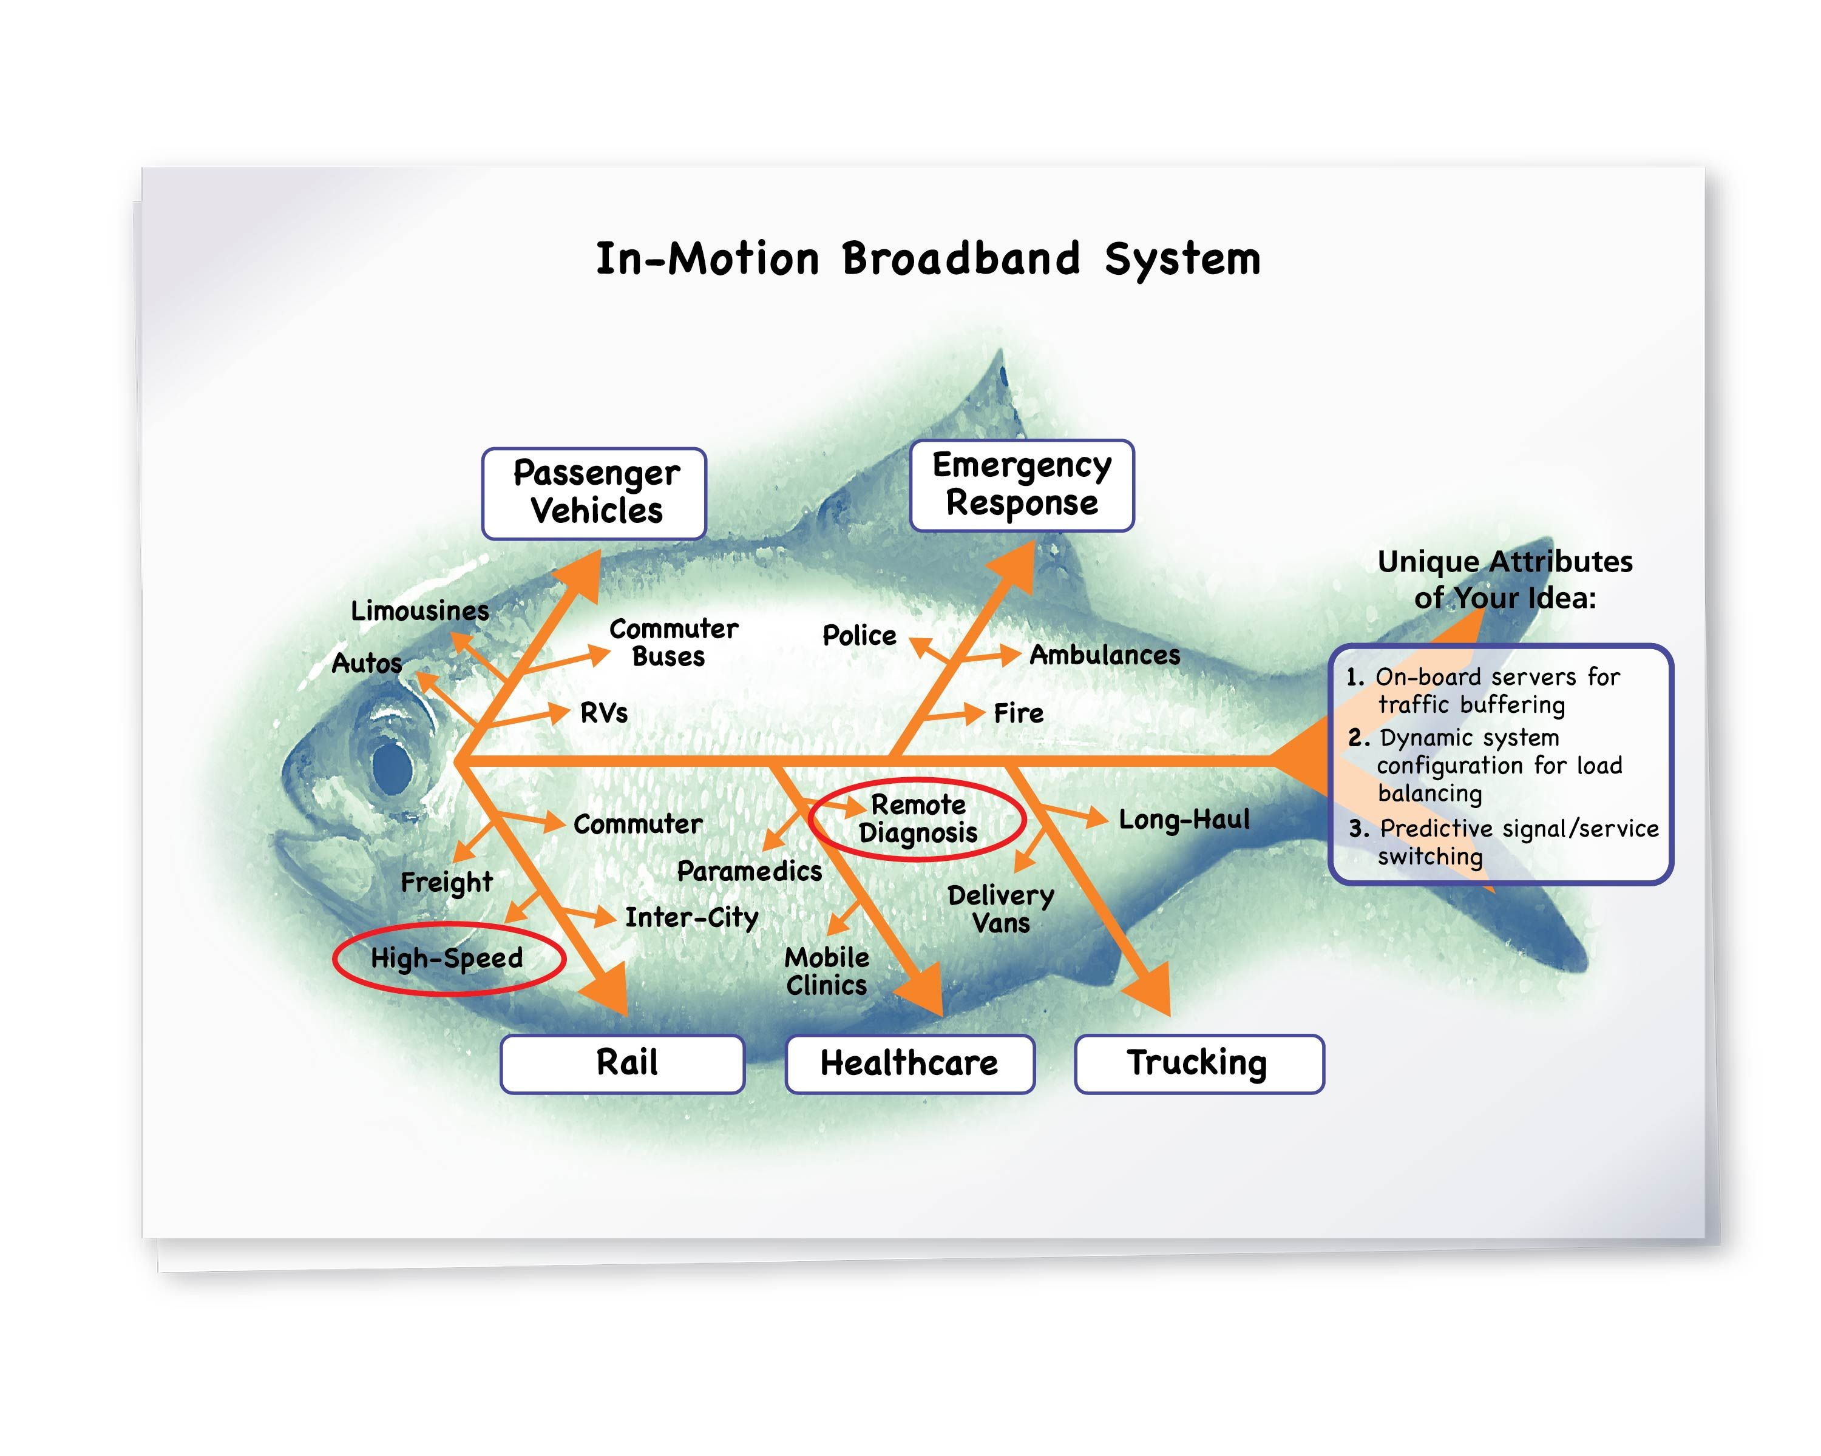
Go To Market Plan – Customer Acquisition

Slide 12
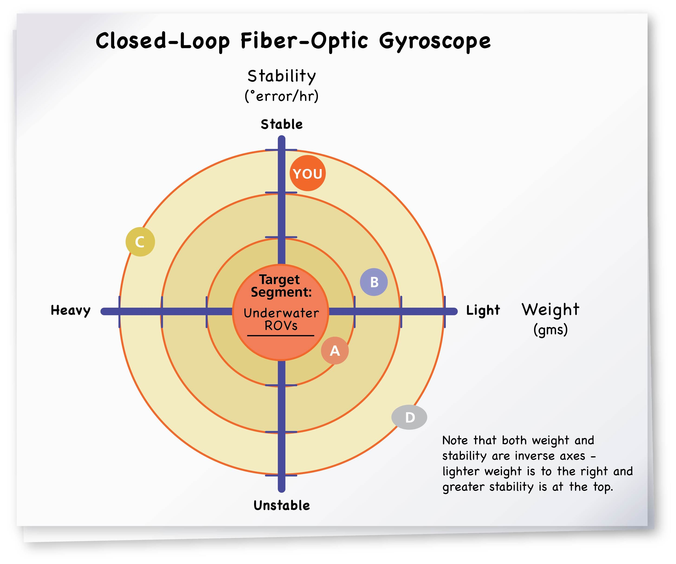
The Competitive Landscape Your Edge
Describe it and/or chart it

Slide 13
The Competitive Landscape Matrix Style
Detail in The Vault
Graphic in The Deck
Feature Comparison
Differentiators

Slide 14
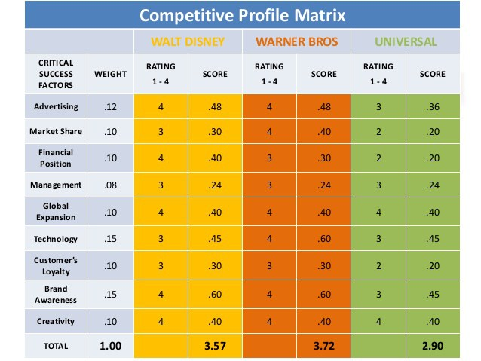
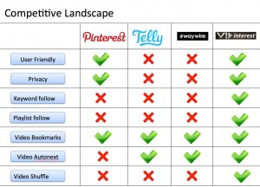
The Competitive Landscape Matrix Style
Examples of Graphic in The Deck
Complex
Simple

Slide 15
Milestones and Progress
2020
2021
2022
2023
2024
$7 mil
$18 mil
Exit
Revenue
Licensing
Stage 1
Preclinical Work and IND submission
Stage 2
1st and 2nd Clinical Studies
Stage 3
Licensing
Milestones and Funding
…on a timeline with funding rounds overlaid…

Slide 16
Intellectual Property/Proprietary Aspects

Slide 17
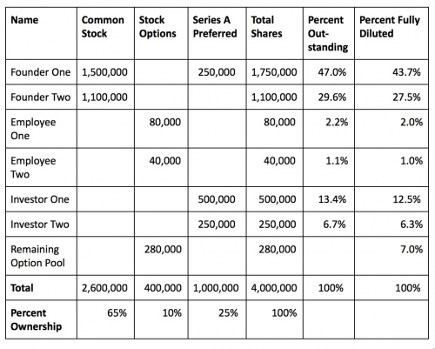
Cap Table

Slide 18
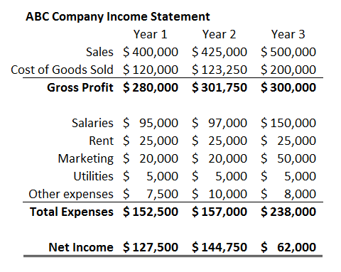
Financials Historical

Slide 19
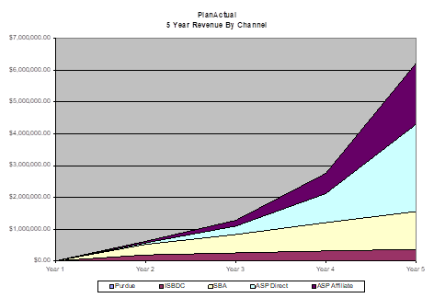
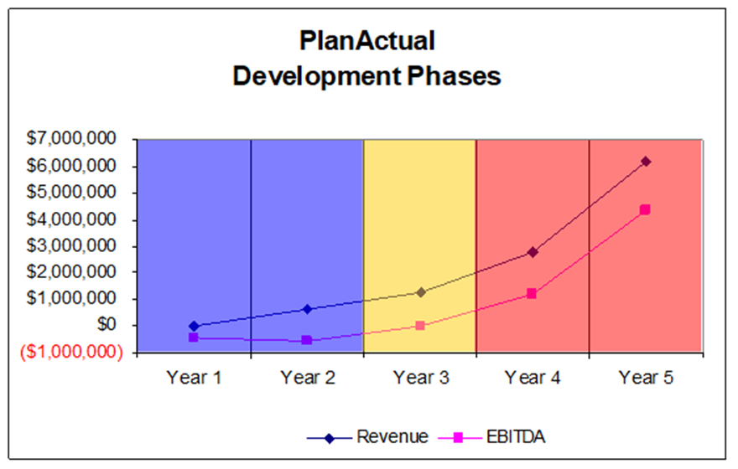
Financials – Projected Preferably Graphed
“A picture is worth a thousand words”

Slide 20
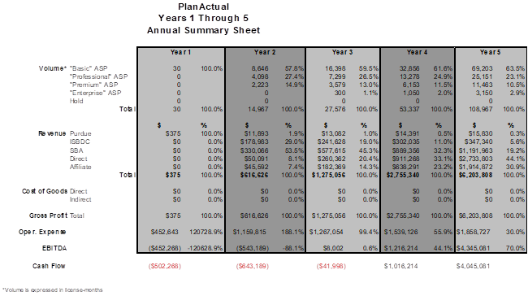
Financials – Projected Detailed Backup
Moderate Detail in Deck
Excruciating Detail in The Vault

Slide 21
Exit Strategy
Depict Your Various Options:
Growth
Acquisition
IPO
Etc.

Slide 22
The Team
Pictures
Include Board
Include Advisors

Slide 23
The Ask
Money
Advice
People

Slide 24
Appendix
Anticipate Questions
Use The Appendix for Further Detail

